Slide 1
Notes:
SICKER, FATTER, POORER… These were the words that I heard one day that jolted me to my TV screen. Oddly enough, it was an answer to a prayer. Why you ask, let me explain…

Slide 2
Sicker, Fatter, Poorer! Exploration of Phthalate Exposure Amongst Various Populations
By UrLeaka Newsome
Notes:
My name is UrLeaka Newsome and today I’m going to talk with you about my research and app in exploring phthalate exposure amongst various populations.

Slide 3
Agenda
Motivation
What are “phthalates” and what’s the big deal?
Current Research
Current Data Exploration

Slide 4
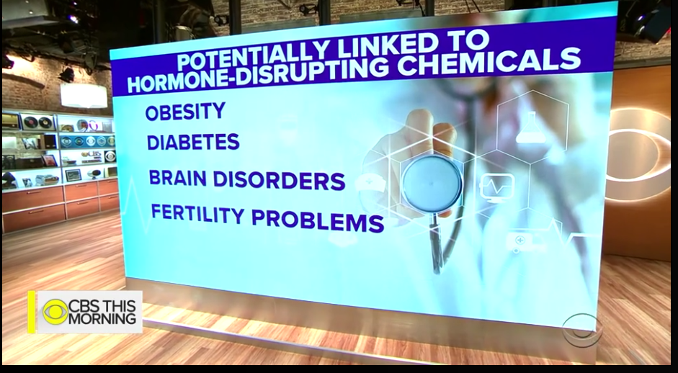
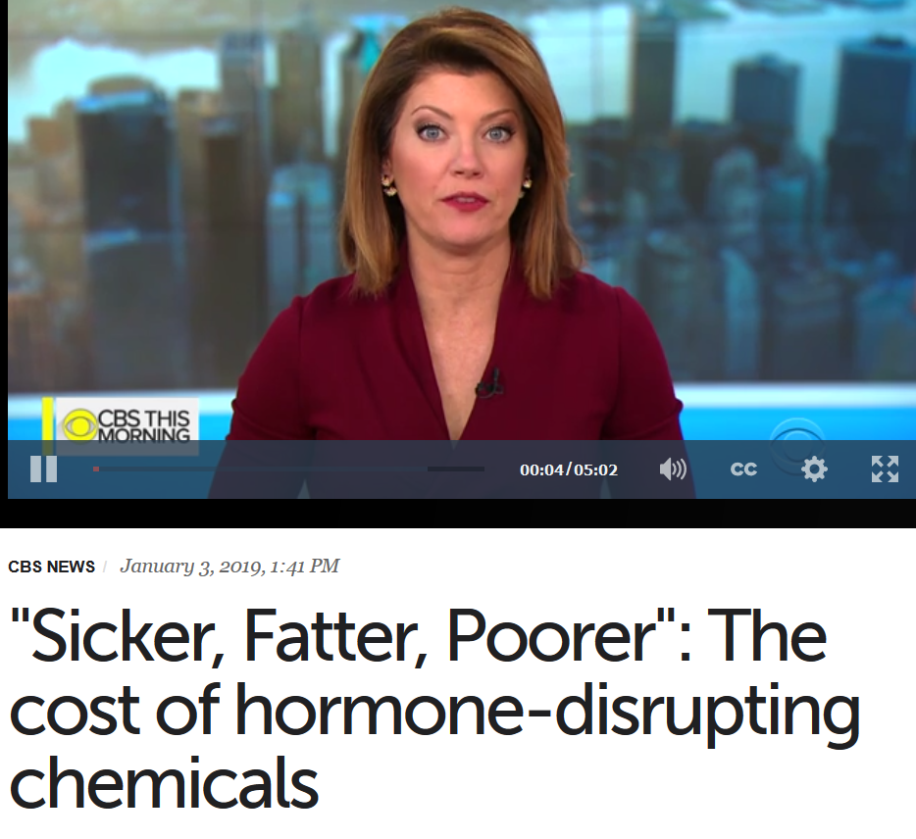
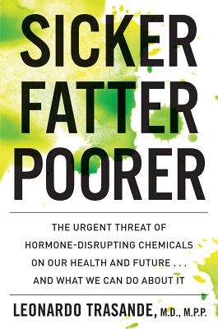
Motivation… a tale of two woes
Notes:
To be honest with you, I went back and forth debating what I’d like my midstone project to be about… STEM education or biomedical research. I’m interested in both… As I sought to allow my ability to find an adequate dataset to help me make my decision, I had a hard time finding a set that would help me answer one of two questions.
I recently viewed a podcast of sorts where a prominent member of my community briefly mentioned a comparison between consumer spending and health disparities for certain groups. She stated that certain groups have a higher rate of health issues and disease, yet are one of the leading consumers of health and beauty aid products.
This peaked my interest and became the premise for my concern… My question was why is this? Why do I talk to my parents and grieve when I hear of their latest health concerns. Wondering what I can do to help. Why do I look out at random people in the grocery store and see people that look like me have an oddly familiar body type. Are we just “big boned”? Why do we obsess about our appearance or hair… Why?
So many questions…. But the answers expand farther than the basis of this research project. Yet I was till intrigued with the prospect of a possible relationship between health and beauty aid consumer products and the overall health of people. Was their a direct connection especially since industry is not regulated by formal organizations such as the FDA. https://www.fda.gov/cosmetics/productsingredients/ingredients/ucm128250.htm. More importantly, how can I find this information…
And then I saw this… CBS intereviewed Dr. Leonardo Trasande a leading researcher in pediatrics and public health. Based on his research, he discovered…
The idea is based on this… We are exposed to various chemicals found in our environment. These chemicals have been understood to cause disruptions in our endocrine or hormone system which has a direct connection to more chronic and serious health conditions.

Slide 5
What are “phthalates”?
“Phthalates are diesters of phthalic acids, a class of industrial chemicals extensively used since the early 20th century as softeners of plastics, solvents in perfumes, and additives to hairsprays and lubricants and as insect repellents.” (Schecter, et. al, 2013)
Phthalates can enter the body through ingestion, dermal absorption, parenteral intake from medical devices, and inhalation. (Just, et.al, 2010)
These chemicals are found in items such as:
PVC (i.e. plasticizer)
Wall coverings
Vinyl gloves
Toys
Child care articles
Food packaging materials
Medical devices
Personal care items (perfumes) (i.e. stabilizer) (Green, et. al., 2005)
Notes:
One of the chemicals studied are “Phthalates”
Among personal care products, DEP and DnBP have been found at the highest concentrations in fragrance products, including perfume (DEP), and in nail polishes (DnBP). Figure 1 shows an adaptation of results from the analysis of DEP in 48 personal care products in the United States (Hubinger and Havery, 2006). The five fragrance products tested had concentrations of DEP ranging from 5486 to 38,663 p.p.m., and the next highest DEP concentration of any other product tested was in a deodorant with 2933 p.p.m. (Hubinger and Havery, 2006). https://www.nature.com/articles/jes201013#ref10

Slide 6
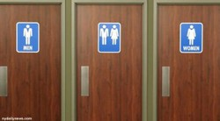
How are phthalates measured?
Measurements can be taken by:
Blood Sample (Serum)
Urine Sample
As a result, phthalates are metabolized and excreted in urine and feces and often metabolized within hours and complete by day 2.
This Photo by Unknown Author is licensed under CC BY
Notes:
Indirect relationship… measure metabolite is a measurement of phthalate absorbed.
Men who used cologne or aftershave within 48 hr before urine collection had higher median levels of monoethyl phthalate (MEP) (265 and 266 ng/mL, respectively) than those who did not use cologne or aftershave (108 and 133 ng/mL, respectively).
Although diester and monoester phthalates have short biologic half-lives of approximately 6–12 hr and do not accumulate (ATSDR 1995, 2001, 2003), the frequent application of personal care products may result in semi-steady-state levels, making it possible to estimate typical phthalate body burden from a single urine sample (Hauser et al. 2004; Hoppin et al. 2002)…. The percentage of African-American (59%) and Hispanic (53%) men who reported using cologne within 48 hr of urine collection was higher the percentage of Caucasian men (25%) or men of other races (25%). Additionally, African-American men (65%) were more likely than Hispanic (44%), Caucasian (30%), or men of other races (43%) to use lotion. https://www.ncbi.nlm.nih.gov/pmc/articles/PMC1310914/

Slide 7
Effects of increased phthalate metabolite
Insulin resistance/Diabetes & obesity
Adverse effects in the adult male reproductive system
Early puberty in females and shortened pregnancies
Endocrine Disruptors
Notes:
Stalhut, 2007
According to the CDC, certain demographic groups have a higher rate of cancer and other health disparities than other groups. Even in the state of California, extensive efforts have been made to clearly assess carcinogenic chemicals and their impact on communities. Consequently, many consumer products are not regulated by the Food and Drug Administration and one must wonder if the lack of regulation and extensive use of products are linked to long term indirect health problems. This study will seek to investigate the potential relationship between chemicals found in health and beauty aid consumer products and possible health disparities amongst varying demographic populations in the United States. Ultimately, if there is a relationship this may elicit questions concerning “ecojustice”.
https://auditor-ca.demo.socrata.com/dataset/Chemicals-in-Cosmetics/ebsf-jhkt
As of right now, there haven’t been any determined threshold levels yet… the research is new.

Slide 8
Data Question
Question: Are there observable differences for phthalate intake amongst varying populations?
Hypothesis: There are significant differences for phthalate intake amongst varying populations?

Slide 9
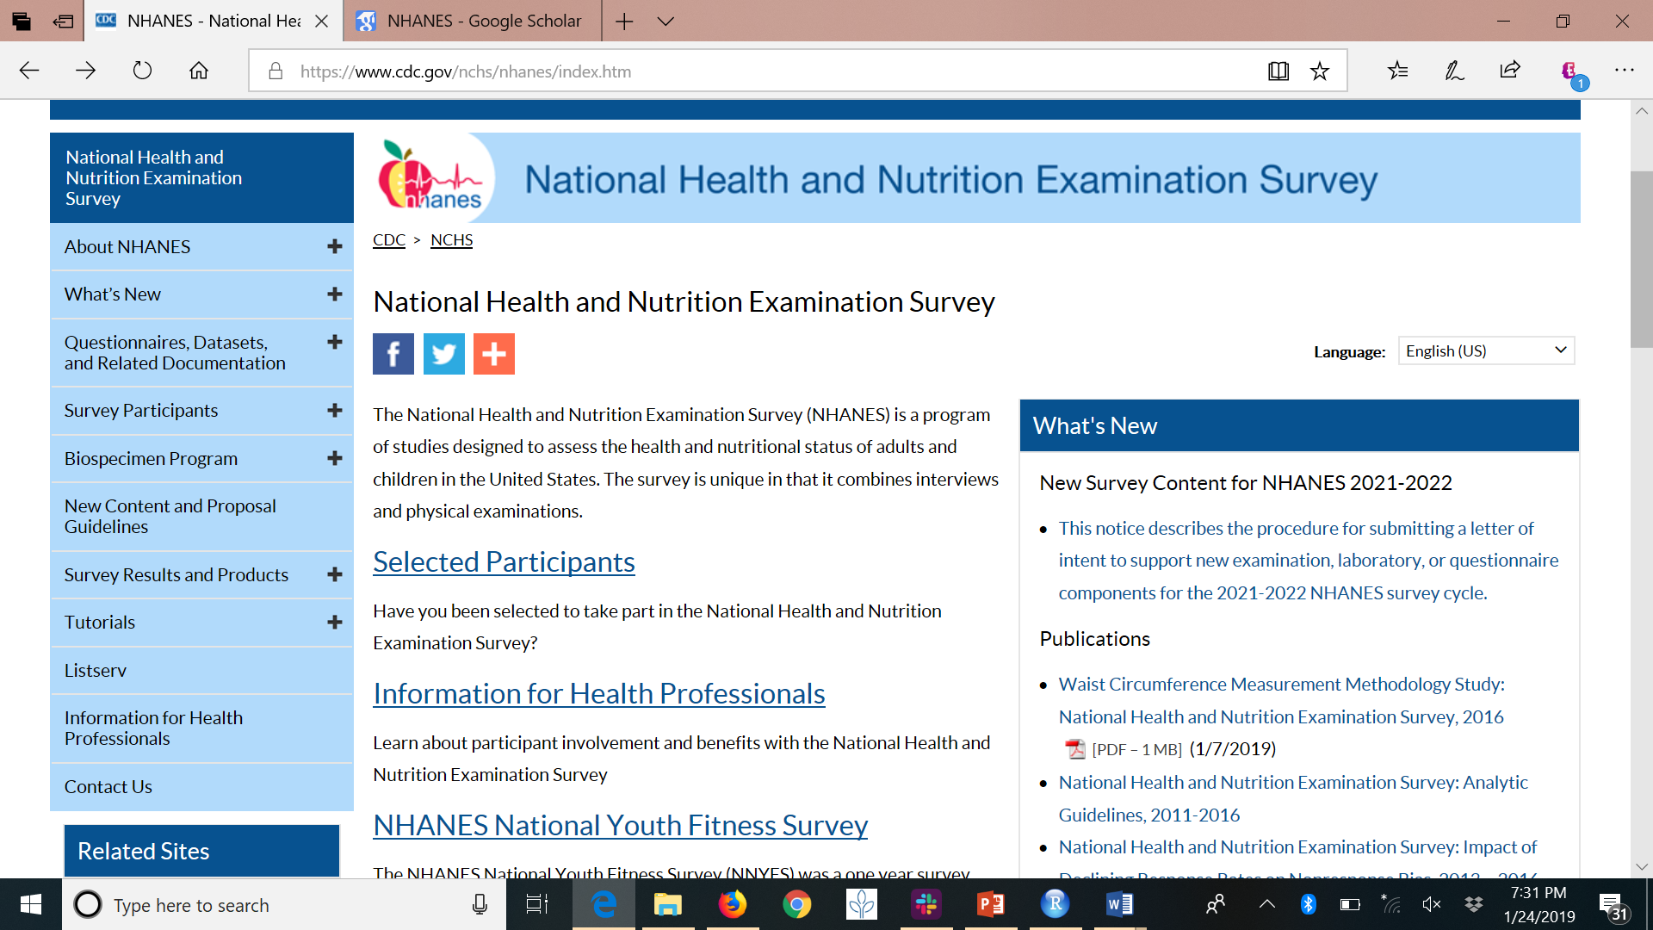
Source of Data
Notes:
While the NHANES program began in the early 1960s, the survey became a continuous program in 1999
This is a long term or longitudinal study in which health and nutritional information for adults and children have been examined and surveyed since 1999 and examines a sample of about 5000 people each year.
The survey is unique in which it combines interviews, physical exams, and laboratory results.
“NHANES is a major program of the National Center for Health Statistics which is a part of the Center for Disease Control (CDC)

Slide 10
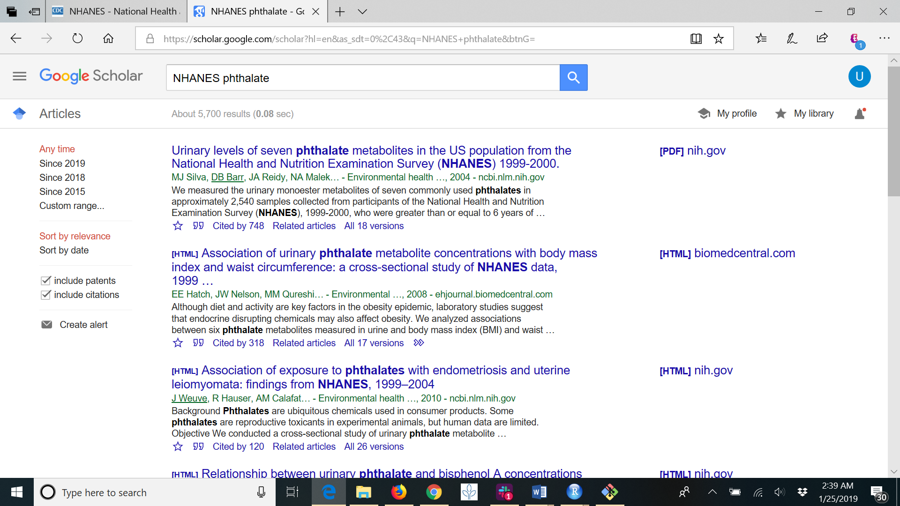
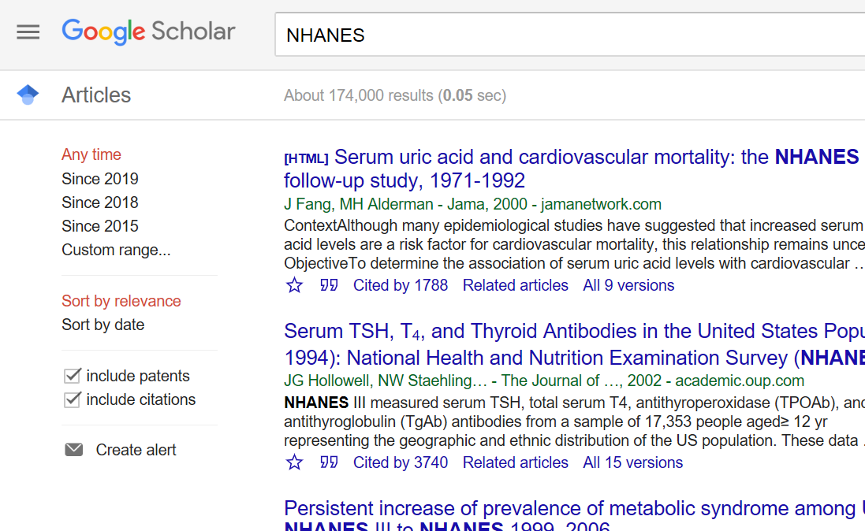
Notes:
So show you the extent of this program, I did a quick google scholar search and you can see….
It’s well documented

Slide 11
Because of the wide scope of data available, I narrowed my research to the following parameters:
Adults only
2015 – 2016
Basic demographics (age, gender, race/ethnicity)
Medical Conditions – any cancer, thyroid issues, or diabetes

Slide 12
Title and Content Layout with Chart

Slide 13
Two Content Layout with Table
First bullet point here
Second bullet point here
Third bullet point here
Class | Group A | Group B
Class 1 | 82 | 95
Class 2 | 76 | 88
Class 3 | 84 | 90

Slide 14
Two Content Layout with SmartArt
First bullet point here
Second bullet point here
Third bullet point here
Step 1
Task Description
Task Description
Step 2
Task Description
Task Description
Step 3
Task Description
Task Description

Slide 15
How can we explore the data?
Let’s Take a Look at the APP

Slide 16
Add a Slide Title - 2

Slide 17
Add a Slide Title - 3

Slide 18
References
Duty, S. M., Ackerman, R. M., Calafat, A. M., & Hauser, R. (2005). Personal care product use predicts urinary concentrations of some phthalate monoesters. Environmental health perspectives, 113(11), 1530.
Green R, Hauser R, Calafat AM, Weuve J, Schettler T, Ringer S, et al. Use of di(2-ethylhexyl) phthalate-containing medical products and urinary levels of mono(2-ethylhexyl) phthalate in neonatal intensive care unit infants. Environ Health Perspect. 2005;113:1222–1225.
Just, A. C., Adibi, J. J., Rundle, A. G., Calafat, A. M., Camann, D. E., Hauser, R., ... & Whyatt, R. M. (2010). Urinary and air phthalate concentrations and self-reported use of personal care products among minority pregnant women in New York city. Journal of Exposure Science and Environmental Epidemiology, 20(7), 625.
Schecter, A., Lorber, M., Guo, Y., Wu, Q., Yun, S. H., Kannan, K., Hommel, M., Imran, N., Hynan, L. S., Cheng, D., Colacino, J. A., … Birnbaum, L. S. (2013). Phthalate concentrations and dietary exposure from food purchased in New York State. Environmental health perspectives, 121(4), 473-94.
Stahlhut, R. W., van Wijngaarden, E., Dye, T. D., Cook, S., & Swan, S. H. (2007). Concentrations of urinary phthalate metabolites are associated with increased waist circumference and insulin resistance in adult US males. Environmental health perspectives, 115(6), 876.

Slide 19
Add a Slide Title - 4

Slide 20
Add a Slide Title - 5

